Slide 1
A CNN accelerator for fruit recognition
VLSI SYSTEM DESIGN - FINAL PROJECT
男童俱樂部
黃昱澄 黃冠予 王昱承
俞杉麒 陳奕萍 賴致文
VLSI FINAL PROJECT
2023.1.12

Slide 2
CONTENTS
1
System architecture
NN architecture
HW architecture
EPU architecture
2
Verification
EPU verification
Full sys verification
3
Overall results
Speed perf
Area perf
Power perf
VLSI FINAL PROJECT
2023.1.12
Notes:
我們會從三個部分來介紹我們的project

Slide 3
1
System architecture
NN architecture
HW architecture
EPU architecture
VLSI FINAL PROJECT
2023.1.12

Slide 4
NN architecture
 | Imap | Kernel | Omap | Note | Time (s)
Conv 0 | 32*32*3 | 3*3*3*60 | 32*32*60 | 3x3 conv | 0.014
Conv 1 | 32*32*60 | 1*1*60*33 | 32*32*33 | 1x1 conv | 0.051
Conv 2 | 32*32*33 | 1*1*33*20 | 32*32*20 | 1x1 conv | 0.019
Poo1 0 | 32*32*20 | 32*32 | 1*1*20 | 32x32 Max | 0.002
Dataset :
Source : Fruit Classification (kaggle)
Number of classes: 20 (fruits and vegetables)
Image size: 32*32
Train : 200 img/per fruit, Total = 4000 images
Test : Average 50 img/per fruit, Total = 1000 images
Final Accuracy = 80.6%
VLSI FINAL PROJECT
2023.1.12
Notes:
我們的dataset是使用kaggle上的fruit classification
原始的dataset 共有33種class
Image size 為32*32
而因為這個dataset裡面，有許多水果是相同的，只是顏色不同，所以我們的蔬果種類就由33種更改成20種
training data set 總共有4000張
而test是1000張
我們使用NIN架構
為一層 3x3 conv layer (3,60)
及兩層 1x1 conv layer (60,33)(33,20)
最後是 max pooling layer
在第一層通過疊加更多的卷積結果，能提取更強的非線性特徵。進而將上層特徵更復雜的映射到下層。
而後面再使用1×1卷積進行降維，來降低計算複雜度。
加上我們在convolution中將Batch Normalization電路做移除以減少延遲
同時不失去太多準確性
最終的結果為
With CLIP-Q
~80.6%

Slide 5
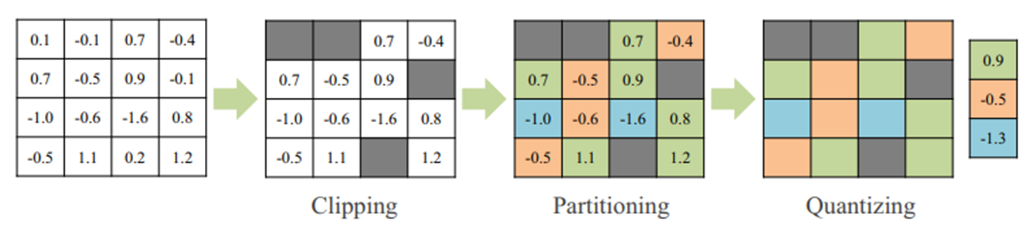
NN architecture
For Example : Conv0
In8.hex
1 20
2 20
3 20
…
3072 20
W2.hex
0EFF8
10_11_11_11_11_10_00
W8.hex
05_FA_ED_00
Bias32.hex
1 00000111
2 FFFFFDEC
3 00000080
…
60 FFFFFFF6
Out8.hex
1 00
2 00
3 00
…
61440 00
VLSI FINAL PROJECT
2023.1.12
Notes:
就是in8 * w2(到w8查表) + bias32 = out8
首先是input.hex代表輸入的值 此處以conv0座表示關係 相片是32*32(pixel) * 3 (channel) 故為3072
接下來因為用2bit做Clip所以W8有四種值，根據W2得出對應的weight值
最後相乘以後加上bias得到輸出out8

Slide 6
HW architecture
IM
Wrapper
(Slave1)
DM
Wrapper
(Slave2)
DMA
(master2)
(slave)
CPU
L1 I$
(master0)
L1 D$
(master1)
IM
DM
AXI bus
EPU wrapper
(slave)
SCtrl
Wrapper
(Slave)
ROM
Wrapper
(slave)
DRAM
Wrapper
(slave)
WDT
Wrapper
(Slave)
Sensor
Ctrl
Bias
Weight
Input
Output Buffer
WDT
Sensor
ROM
DRAM
(Off-chip)
(Off-chip)
(Off-chip)
VLSI FINAL PROJECT
2023.1.12

Slide 7
EPU architecture
EPU structure
Weight buffer(180KB)
Bias buffer(2KB)
Input buffer(384KB)
Output buffer(384KB)
EPU mode
Conv3x3
4PE,each with 9 MACs
zero padding
Relu
Conv1x1
1PE with 9 MACs
Relu
Max pooling
EPU
Input
16 bit
Max
Pooling
Conv
1x1
Output
16 bit
PE0
Bias
32 bit
Conv
3x3
PE0
PE1
Weight
18 bit
PE2
PE3
VLSI FINAL PROJECT
2023.1.12

Slide 8
2
Verification
EPU Verify
FULL Sys Verify
VLSI FINAL PROJECT
2023.1.12

Slide 9
EPU verification
Stand-alone testbench for EPU
TB loads input/weight/bias data into RTL-simulated SRAM buffers.
TB pulls start signal to high
EPU starts computation and writes results to output buffer.
EPU pulls finish signal to high
TB verify the content of output buffer.
 | Imap | Kernel | Omap | Note | Time (s)
Conv 0 | 32*32*3 | 3*3*3*60 | 32*32*60 | 3x3 conv | 0.014
Conv 1 | 32*32*60 | 1*1*60*33 | 32*32*33 | 1x1 conv | 0.051
Conv 2 | 32*32*33 | 1*1*33*20 | 32*32*20 | 1*1 conv | 0.019
Poo1 0 | 32*32*20 | 32*32 | 1*1*20 | 32*32 Max | 0.002
VLSI FINAL PROJECT
2023.1.12

Slide 10
Full sys verification
Program flow
Assume ALL input/weight/bias data in DRAM.
CPU runs booting program with DMA.
Use DMA to move data from DRAM to EPU’s buffer.
CPU writes to EPU ctrl registers.
8-bit weight shared by that layer
“start” signal
EPU writes to output buffer as CPU stuck at WFI.
EPU finishes and send interrupt. CPU continues with ISR.
CPU writes ctrl signals for next layer.
Trigger “In-Output buffer swap”
Output of this layer is the input of next layer
If done, DMA move data from EPU to DRAM.
TB verify the content of DRAM.
VLSI FINAL PROJECT
2023.1.12

Slide 11
3
Overall results
Speed perf
Area perf
Power perf
VLSI FINAL PROJECT
2023.1.12

Slide 12
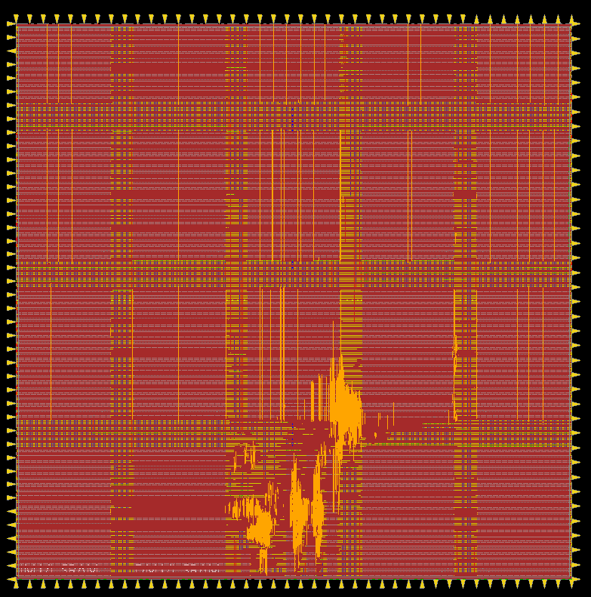
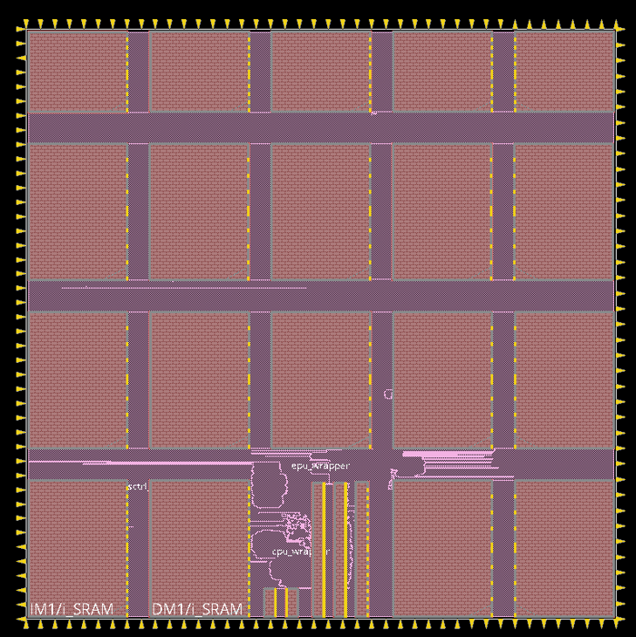
Overall Results
Clock period | 12.5ns
Area | 69447383.21 um^2
Power | 304.26555650mW
VLSI FINAL PROJECT
2023.1.12

Slide 13
Q&A

